Slide 1
63rd Meeting of the Nordic Hydrographic Commission (NHC) Helsinki, April 2019 IHO Secretariat Report Abri Kampfer IHO Director

Slide 2
Oral report of the IHO Secretariat along the IHO Work Programme
Corporate Affairs
Hydrographic Standards and Services
Inter Regional Cooperation and Support
IHO Secretariats operations

Slide 3
Corporate Affairs / 2nd IHO Council
Important discussions about S-100, shape of Capacity Building, Crowd Source Bathymetry and Strategic Plan review
Council brings new vigour to the intersessional operations of the IHO
NHC is well represented (3 of 30) – Sweden occupy seat allocated to NHC
3rd Council: 15-17 Oct 19. Proposals by 15 Jul (CCL1/19)
Notes:
Three months before an ordinary session of the Assembly, the Secretary-General shall inform the Chair of the RHC of: a. the number of seats allocated to the RHC, and b. those Member States that are eligible for selection by the RHC.

Slide 4
2. Hydrographic Standards and Services
Progress within the S-100 framework
Data Quality Maintenance Working Group (DQMWG) update

Slide 5
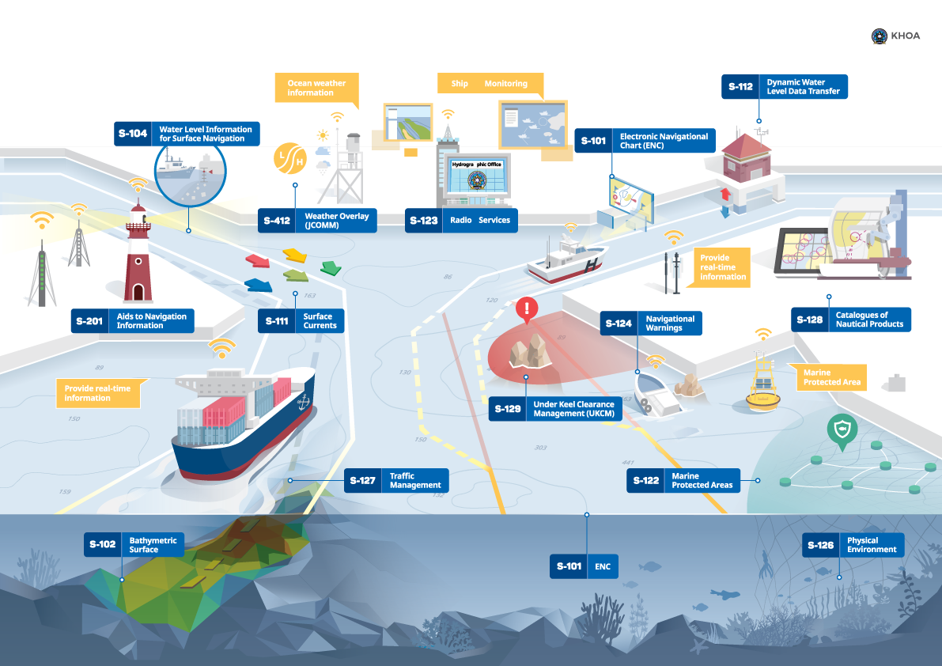
HSSC / S-100 Progress

Slide 6
HSSC / S-100 Progress
S-100 and dependant Product Specification - Key Milestones
S-100 Edition 4 released - December 2018;
S-101 ENC Product Specification Edition 1.0.0 released for testing – December 2018;
S-102 High Resolution Bathymetry Edition 2.0.0 – anticipated release 2019
S-111 Surface Currents Product Specification, Edition 1.0.0 released for testing - December 2018;
S-122 Marine Protected Areas, Edition 1.0.0 released - January 2019;
S-123 Marine Radio Services, Edition 1.0.0 released - January 2019;
S-129 Underkeel Clearance Management System Edition 1.0.0 – anticipated release 2019
S-211 (IALA) Port Call Message Product Specification Edition 1.0.0 – anticipated release 2019
S-411 (WMO) Ice Information Product Specification Edition 1.0.0. – published 2017
S-412 (WMO) Weather Overlay Product Specification Edition 1.0.0 – published 2017
S-421 (IEC) Rout Exchange Product Specification Edition 1.0.0 – anticipated 2020
Testbed Projets - 2019
KHOA
SPAWAR
Notes:
S-100 Edition 4 - Major Extensions include
• Online Communication Extension requested by IALA
• Scripting language support – requested by OEMs
• Lua Portrayal support – requested by OEMs
• Inclusion of bSpline Spatial – requested by WMO
• Data Protection
Port Call Messaging - A Port Call Message is a vector dataset containing all relevant information in a communication of port call information between ship and port, ship to ship, VTS or other shore authorities

Slide 7
HSSC / DQMWG update – MASS needs quality of data
Harmonization of data quality indicators, describing to allocate S-44 values for different types of survey techniques and move to CATZOC values.
Crowd Source Bathymetry Data is assigned CATZOC = D.
Satellite Derived Bathymetry is assigned CATZOC = C.
LIDAR data is assigned CATZOC = B, one member sometimes assigns CATZOC = A2.
Surveys from ports are usually assigned CATZOC = B, some port authorities assign CATZOC = A1, to be evaluated by the HO on a port-by-port basis.
Some members do not downgrade CATZOC over time due to temporal variation but provide M_SREL data.
Outcome: Guidance on quality aspects to allocate meaningful quality values of bathymetric data in future S-101 ENC. Description of a convertor of S-57 (CATZOC) to S-101 (QoBD).

Slide 8
3. Inter Regional Cooperation and Support
ENC coverage and overlap update
Crowd Sourced Bathymetry update
Iridium as new Marine Safety Information provider

Slide 9
IRCC / ENC coverage and overlap update
IC-ENC’s Overlapping Data Reporting and Analysis (WENDWG9 WP)

Slide 10
IRCC / Crowd Source Bathymetry
B-12 Ed 2.0.0 Guidance on Crowd source bathymetry is out for voting (IHO CL11 refers).
IHO CL11 comes with a separate template to seek for national acceptance of CSB in national waters of jurisdiction.
Target date for approval of B-12 Guidance on Crowd source bathymetry Edition 2.0.0 was 5th April 2019.
(36 Replies, 33 Yes)
Target date for reply of national position on CSB in waters of national jurisdiction is 20th May 2019.

Slide 11
IRCC / Iridium as new MSI provider (1)
Maritime Mobile Satellite Services provided by Iridium Satellite LLC are now recognized for use in GMDSS.
Draft interim preliminary text of a WWNWS system service manual be presented to MSC 101 for wider publication to allow Initial Operational Certificates (IOC) to be issued to selected NAV and MET Area Coordinators and RCCs, which will enable operational testing of the system and services.
It is proposed that an expanding number of certificates will be issues throughout 2019 so that Full Operational Certificates (FOC) can be issued around the end of 2019.
The necessary SOLAS amendments are planned to come into force on 1 January 2020, after which Iridium can commence full operational service.

Slide 12
IRCC / Iridium as new MSI provider (2)
All NAV and MET Area Coordinators and RCCs will be required to provide MSI and SAR services via all recognized mobile satellite service providers, i.e. Inmarsat and Iridium.
To meet their SOLAS requirements, ships will be required to carry either a type approved Inmarsat or Iridium receiver, they can of course carry one of each to meet the spare backup requirement.
All information providers will be required to transmit their messages via both Inmarsat and Iridium, and in the future via all other IMO appropriate recognized mobile satellite service providers, global or regional coverage, such as BeiDou and the UAE based Thuraya satellite system, which has applied for recognition for the Gulf region.
Note at present, unlike GNSS, there are no multi-system capable ship receivers available.
NHC Action: Take note of the anticipated rearrangements and prepare information for affected shipping industry.

Slide 13
4. IHO Secretariats operations
Renewal of INToGIS Service interface
Online voting for CLs
Ongoing activities on a technical overhaul of IHO Secretariat´s communication channels
Social media
Corporate Design
Website
Preparations for IHO Centenary celebrations

Slide 14
Secretariats operations / INToGIS II

Slide 15
(for CL response, C-55 and P-5)
Secretariats operations / online voting (CL20/19)
Member States will be able to submit their information directly from IHO Online form system. It will be soon announced with its password to enter.
It will be used for CL voting and IHO publications C-55 and P-5 (Yearbook) updating.
Data providers are requested to put two email addresses (one: personal, the other: official HO address listed in P-5) They will receive a PDF receipt message when data is submitted.
The traditional submission (postal letter, fax, email) is also available.

Slide 16
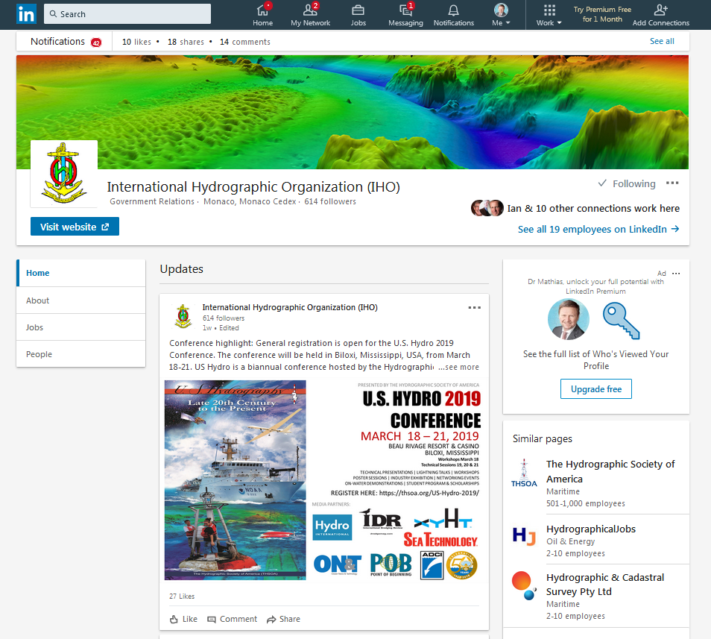
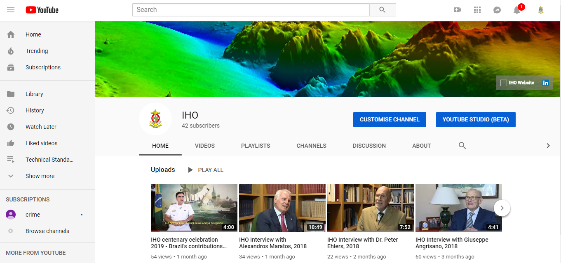
Secretariats operations / social media
Thanks to US remote secondment, the Secretariat is now active under LinkedIn and youtube.

Slide 17
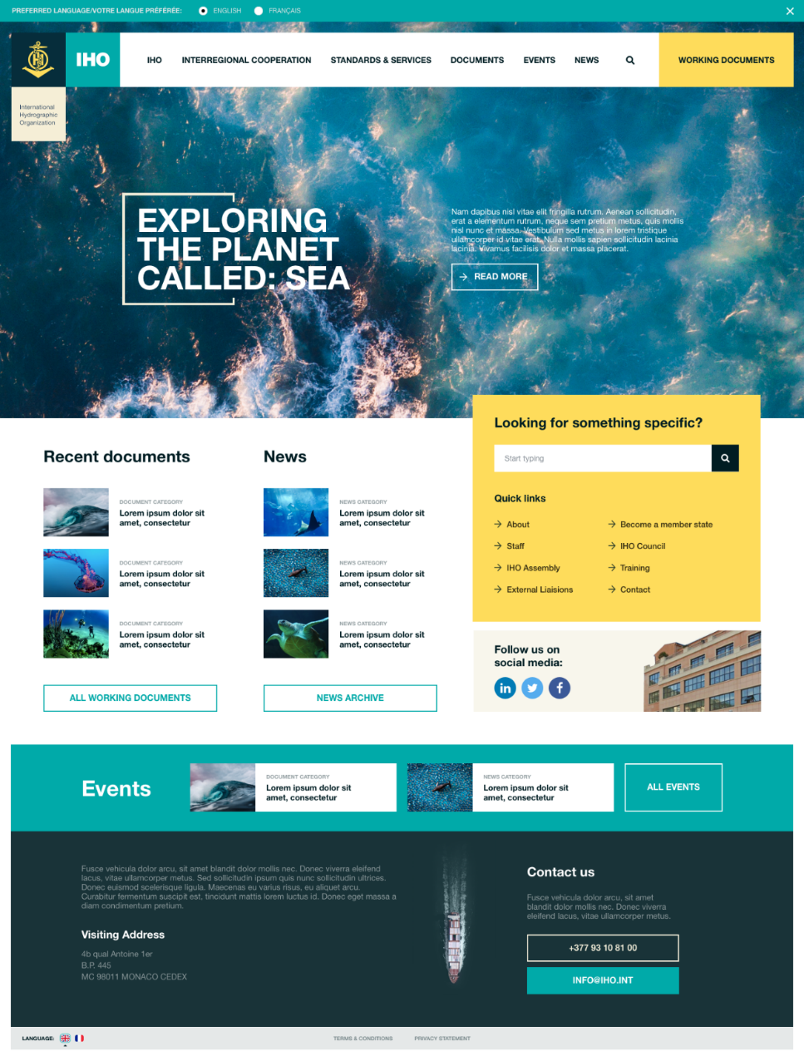
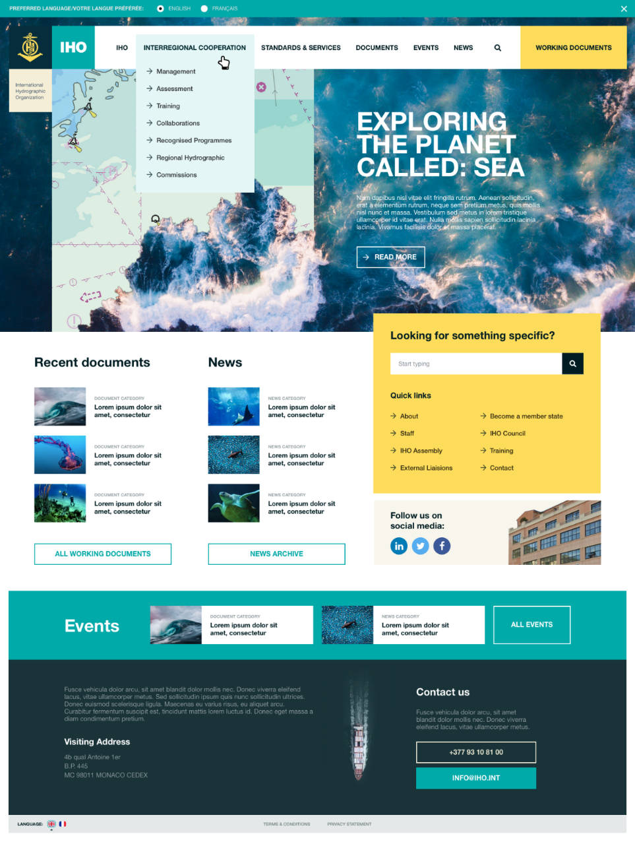
Secretariats operations / IHO website: new creative design homepage

Slide 18
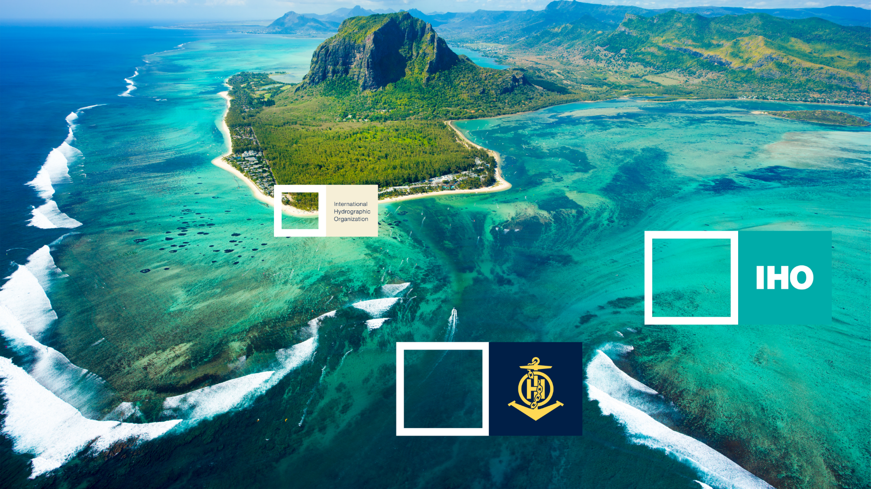
Secretariats operations / inspirations

Slide 19
Secretariats operations / New emblem

Slide 20
New corporate design: Publications

Slide 21
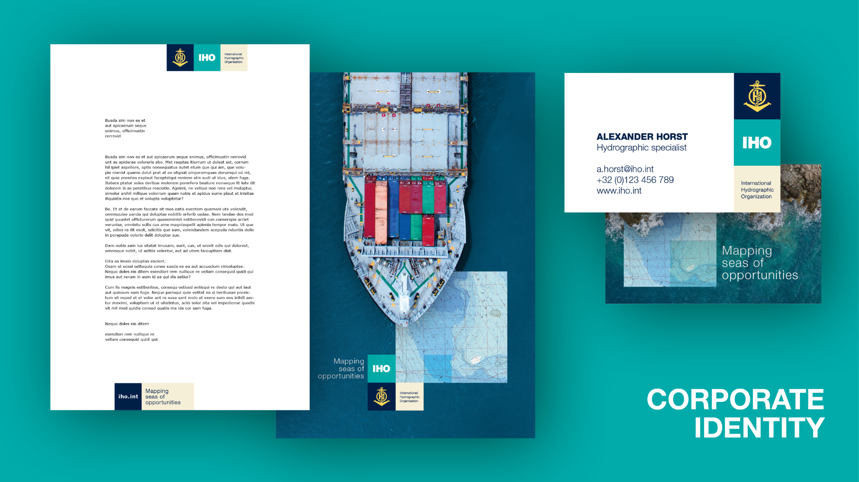
Secretariats operations / New corporate design: Letters etc.

Slide 22
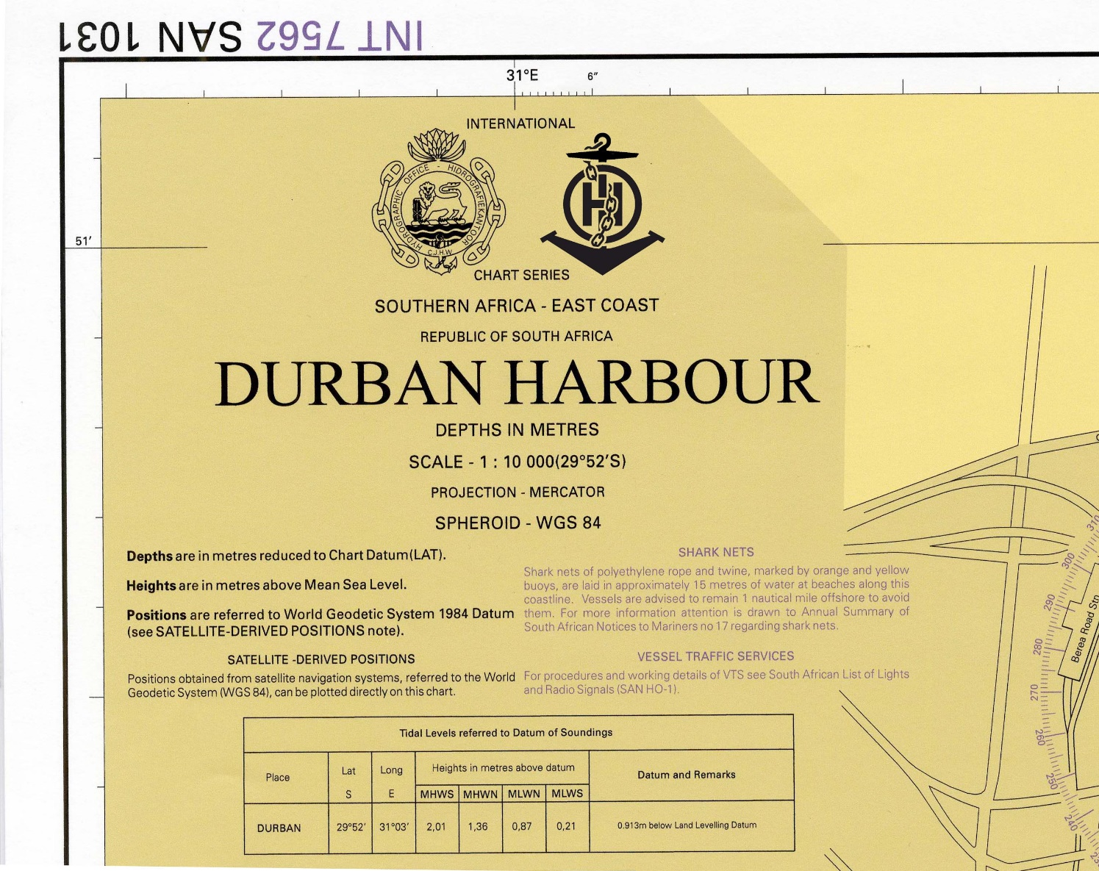
Secretariats operations / New corporate design: INT Charts

Slide 23
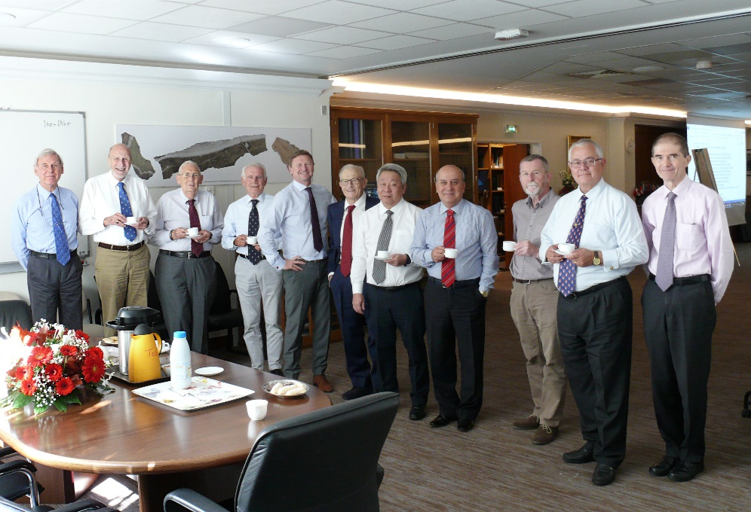
Secretariats operations / IHO 100 years (1)
IHO Prestige book project: “100 years of international cooperation in hydrography”
Illustrate in an educational and entertaining manner the importance and variety of the activities, outputs and developments of the IHO and its effective role in supporting maritime activities: History, Present and Future!
Group of Co-Authors led by Editor in Chief: Gilles Bessero
Chris Andreasen
Mike Barritt
Hans-Werner Schenke / Shin Tani
Peter Ehlers
Hugo Gorziglia
Horst Hecht / Giuseppe Angrisano
Mathias Jonas
Alexandros Maratos
Parry Oei
Robert Ward
Shepard Smith

Slide 24
Secretariats operations / IHO 100 years (2)
Monaco, April 2019:
Historic Nautical Charting and the Mediterranean – Exhibition at Monaco Yacht Club
Monaco, 21 June 2019:
Symposium “Historical Approach for Measurements and Protection of Oceans and World Waters’’ ” to be held at the Oceanographic Museum of Monaco
Monaco, April 2020:
Second IHO Assembly:
Special session about the history of the Organization
New approach for the chart exhibition – science on a sphere
Notes:
The main activities scheduled for the IHO centenary celebrations, coordinated by the IHO Secretariat are as follows (CL 32/2017 refers):
- To hold an exhibition on "Historical Nautical Charts and Mediterranean" which will be displayed at the Monaco Yacht Club from 1 to 13 April 2019,
- To organize an international Symposium on “A Historical Approach for Measurements and Protection of Oceans and World Waters’’ is scheduled to be held at the Oceanographic Museum of Monaco from 20 to 21 June 2019 (in conjunction with the World Hydrography Day), Call for Papers of this Symposium has already been circulated.
- To highlight the centenary celebrations as part of the media and press-campaign associated the Council meetings in 2019 and 2021.
- To organize a half day special session on IHO-100 at the 2nd Session of the IHO Assembly(A-2) in April 2020.
- To prepare, publish and distribute an IHO Prestige Book on “100 Years of International Cooperation in Hydrography”.
The centenary events could also be linked with the United Nations Decade of Ocean Science for Sustainable Development (2021-2030) which has been coordinated by the IOC of UNESCO.

Slide 25
Secretariats operations / IHO 100 years (3)
Monaco, 21 June 2021:
Peak event back to back with IRCC annual meeting:
“100 years of international cooperation in hydrography”
Consider a submission to the UN General Assembly session of 2021:
Commitment of IHO to Sustainable Development Goals through improved provision of hydrographic knowledge (?)

Slide 26
Hydrographic information driving marine knowledge
NHC is requested to take note of this report and take action as deemed appropriate.

